Slide 1
Introduction to Java Programming
History, Syntax, and Core Concepts
Presented By: Mirazul Islam Adjunct Lecturer, NUB

Slide 2
Table of Content
Brief History of Java
Features of Java
Applications of Java
Key Differences Between Java and C++
Sample Java Program
Data Types in Java
Basic Concepts of OOP
Abstraction
Encapsulation
Inheritance
Polymorphism

Slide 3
Brief History of Java
Developed by Sun Microsystems in the mid-1990s.
Originally called "Oak"; renamed Java in 1995.
Java 1.0 released in 1996.
It is now owned by oracle, and more than 3 billon devices run Java.

Slide 4
Features of Java
Java
Object Oriented
Secured
Platform Independent
Multi
threading

Slide 5
Applications of Java
Desktop GUI
Mobile App
Game Development
Web Based App
Enterprise
Scientific

Slide 6
Key Differences Between Java and C++
Feature | Java | C++
Paradigm | Purely Object-Oriented (except for primitive types) | Supports both Procedural and Object-Oriented Programming
Platform Dependency | Platform-Independent (Runs on JVM) | Platform-Dependent (Compiled to Machine Code)
Memory Management | Automatic Garbage Collection | Manual Memory Management (new/delete)
Multiple Inheritance | Not supported (Uses Interfaces) | Supported
Pointers | Does not support explicit pointers (for security) | Fully supports pointers
Compilation & Execution | Compiled to Bytecode and runs on JVM | Compiled directly to machine code
Speed & Performance | Slightly slower due to JVM overhead | Faster as it compiles to native code

Slide 7
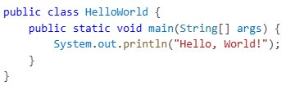
Sample Java Program
Java Source Code (.java file)
Java Compiler
Bytecode File (.class file)
JVM
Machine Code

Slide 8
Data Types in Java
Data Type
Primitive
Non-Primitive
string
Boolean
Numeric
array
etc.
Character
Integral
Integer
Float
byte
boolean
char
short
float
int
double
long

Slide 9
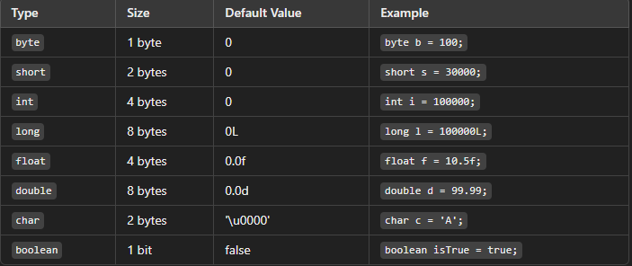
Primitive data types

Slide 10
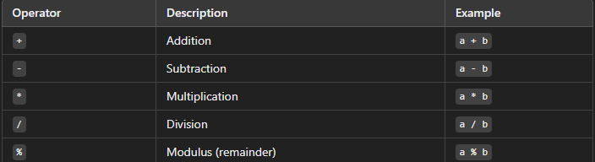
Operators in Java
Mathematical operations.

Slide 11
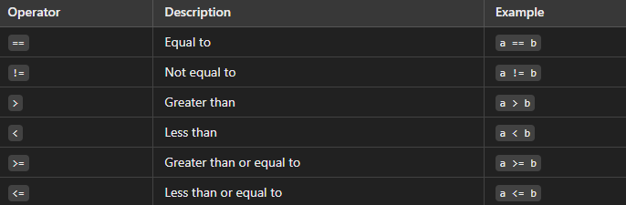
Relational (Comparison) Operators
int x = 5, y = 10; System.out.println(x < y); // Output: true

Slide 12
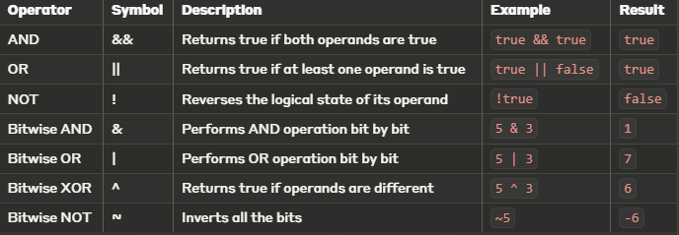
Logical Operators

Slide 13
Control Flow:
Control flow determines the order of execution of statements in Java.
Java provides different types of control flow statements: - Conditional Statements (if, if-else, switch)
- Looping Statements (for, while, do-while)
- Jump Statements (break, continue, return)

Slide 14


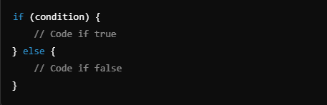
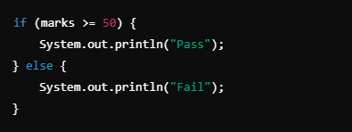
Conditional Statement

Slide 15
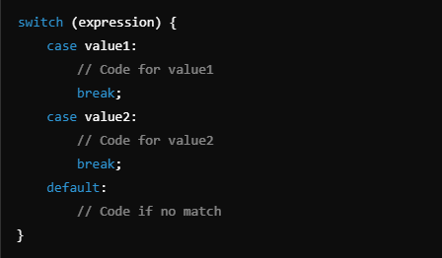
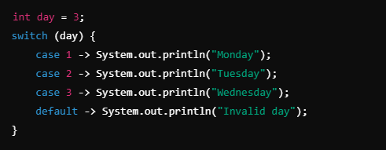

Slide 16

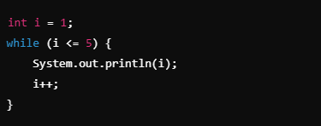

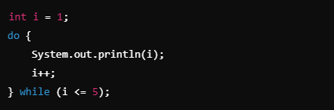

Looping Statement

Slide 17
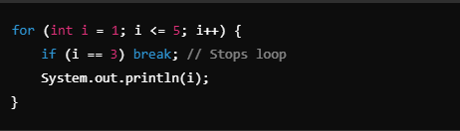
Jump Statement
Break statement (Exit Loop)

Slide 18
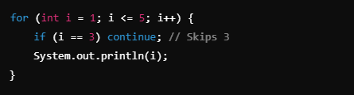
Jump Statement(Cont..)
Continue Statement(Skip Iteration)

Slide 19
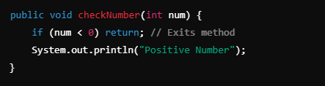
Jump Statement(cont..)
Return Statement(Exit Method)

Slide 20


Strings in Java
A String in Java is a sequence of characters.
Strings are immutable (once created, they cannot be changed).
Defined using the String class in Java
Stored in String Pool
Stored in Heap Memory

Slide 21


String Comparison
Using equals() (Checks content)
Using == Operator (Checks reference)

Slide 22
What is the String Pool?
String Pool (also known as String Intern Pool) is a special memory area in Java's Heap memory to optimize memory usage.
It stores unique string literals to save memory and improve performance.
Implements the concept of "string interning"

Slide 23
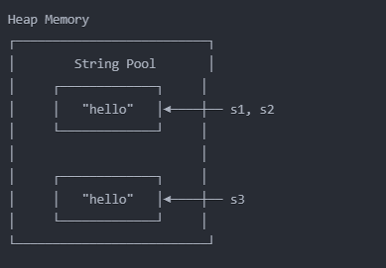


Slide 24
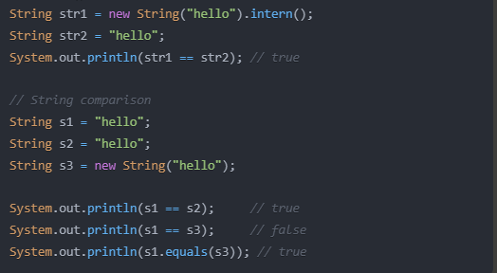

Slide 25
Basic Concepts of OOP
Object
Class
Encapsulation
Inheritance
Abstrac
tion
Polymor
phism

Slide 26
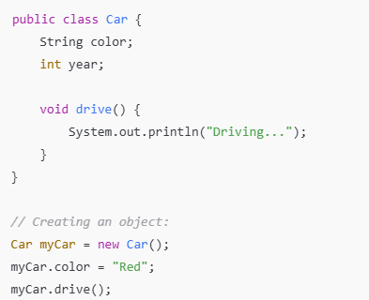
Objects and Classes
Classes:
Blueprint for objects.
Define attributes (fields) and behaviors (methods).
Objects:
Instances of classes.
Created using the new keyword.

Slide 27
Abstraction
Hides implementation details and only exposes the essential functionalities.
Ways to Achieve Abstraction in Java.
Abstract classes
A class with abstract methods.
Interfaces
Allow multiple inheritance.
Can’t be instantiated.

Slide 28
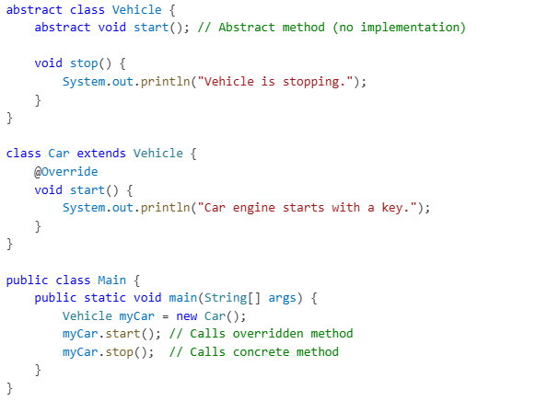
Abstract Classes
Useful when classes share common behavior but also require some unique implementation.

Slide 29
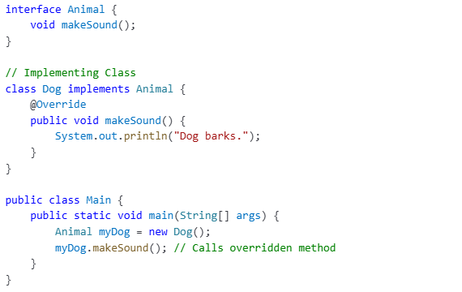
Interfaces
A class can implement multiple interfaces, unlike inheritance.

Slide 30
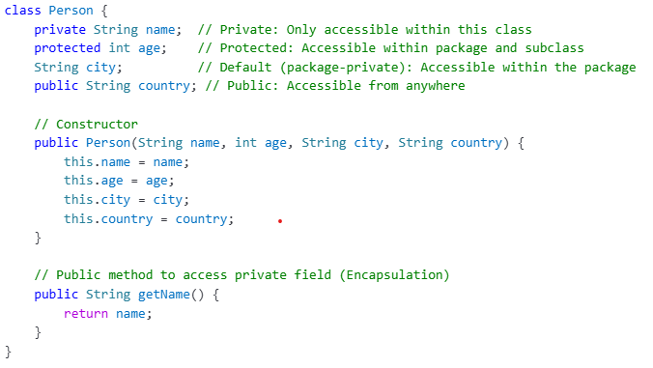
Encapsulation
Wrapping of data and functions into a single unit

Slide 31
Inheritance
A child class (subclass) inherits properties and behaviors (methods) from a parent class (superclass).
Types of Inheritance in Java
Single Inheritance
Multilevel Inheritance
Hierarchical Inheritance
Multiple Inheritance(via interface)

Slide 32
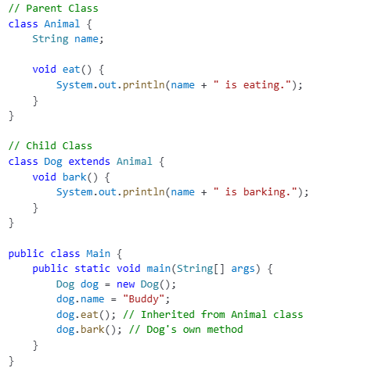
Single Inheritance
Base Class
Clild Class

Slide 33
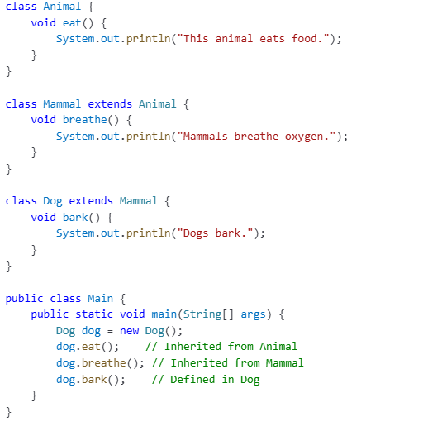
Multilevel Inheritance
Base Class
Intermediate Class
Derived Class

Slide 34
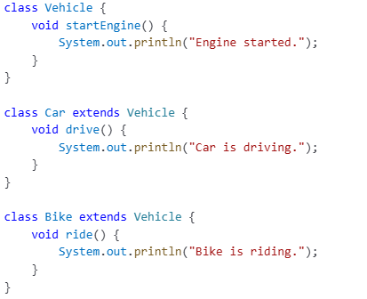
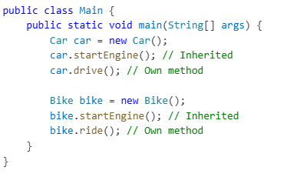
Hierarchical Inheritance
Base Class
Derived Class
Derived Class

Slide 35
Polymorphism
allows a single interface to represent multiple behaviors.
Types of Polymorphism in Java.
Compile-time Polymorphism(Method Overloading)
multiple methods with the same name but different parameters.
Run-time Polymorphism(Method Overriding)
The method call is resolved at compile time(static binding).
Same method name, same parameters but defer in subclass.
The method call is determined at runtime(dynamic binding).

Slide 36
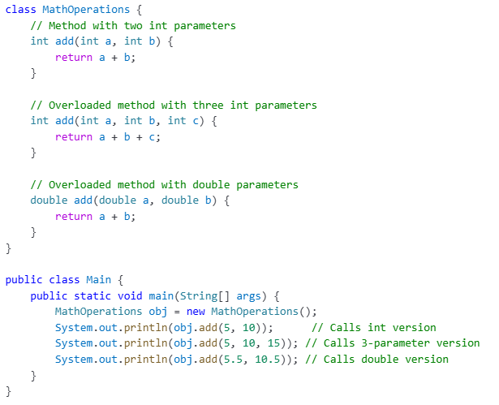
Method Overloading

Slide 37
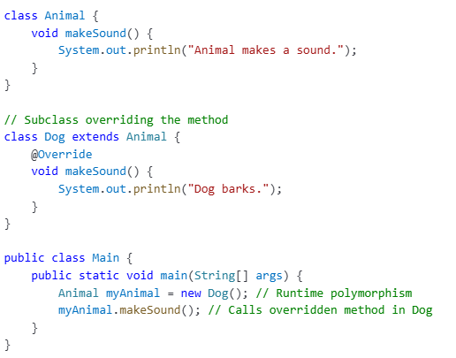
Method Overriding

